Slide 1
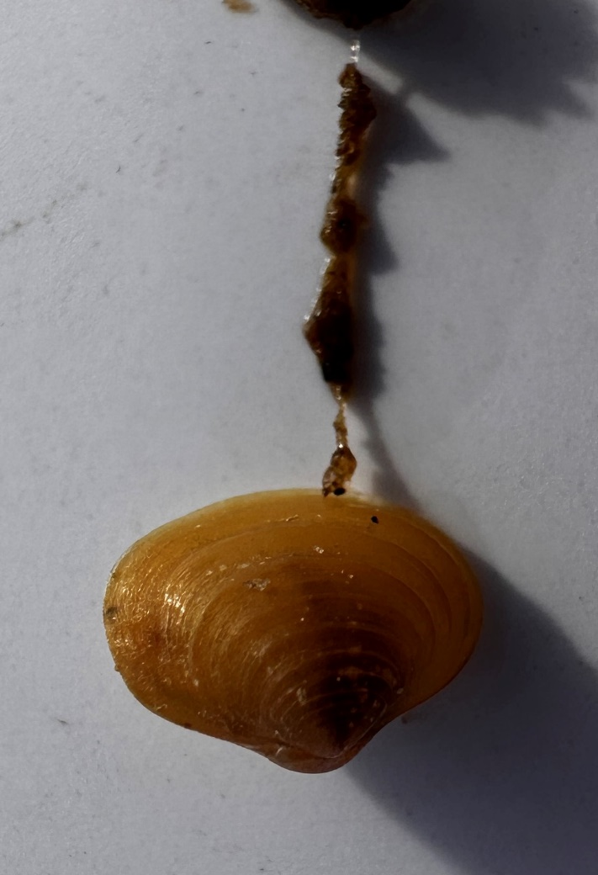
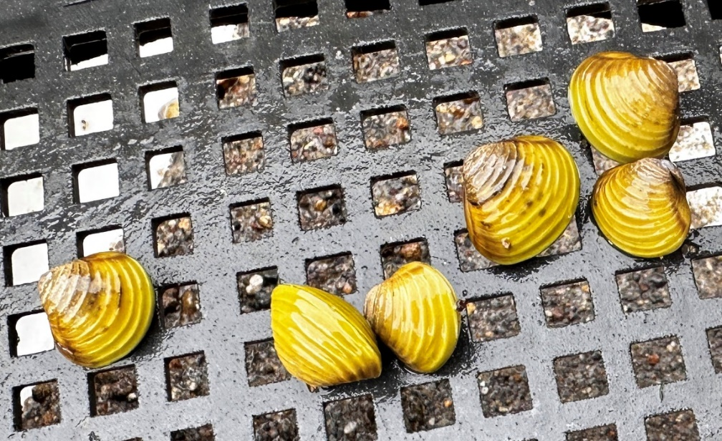
Freshwater gold clam (Corbicula fluminea)
Juvenile clams produce a sticky (byssal) thread
02/25

Slide 2
Know your gold clams from your native pea clams and juvenile kākahi/kaeo
Adult kākahi/kāeo are large and black
Smaller kākahi/kāeo may be golden or have a green tinge (no defined ridges on shell)
Sphaeriidae (native pea-clam) no ridges on the shell
Juvenile kākahi are very pale/pearl-like with ridges
Juvenile gold clam (Corbicula fluminea) distinct ridges on the shell
cm
Further information contact: Deborah Hofstra (deborah.hofstra@niwa.co.nz)

